Slide 1
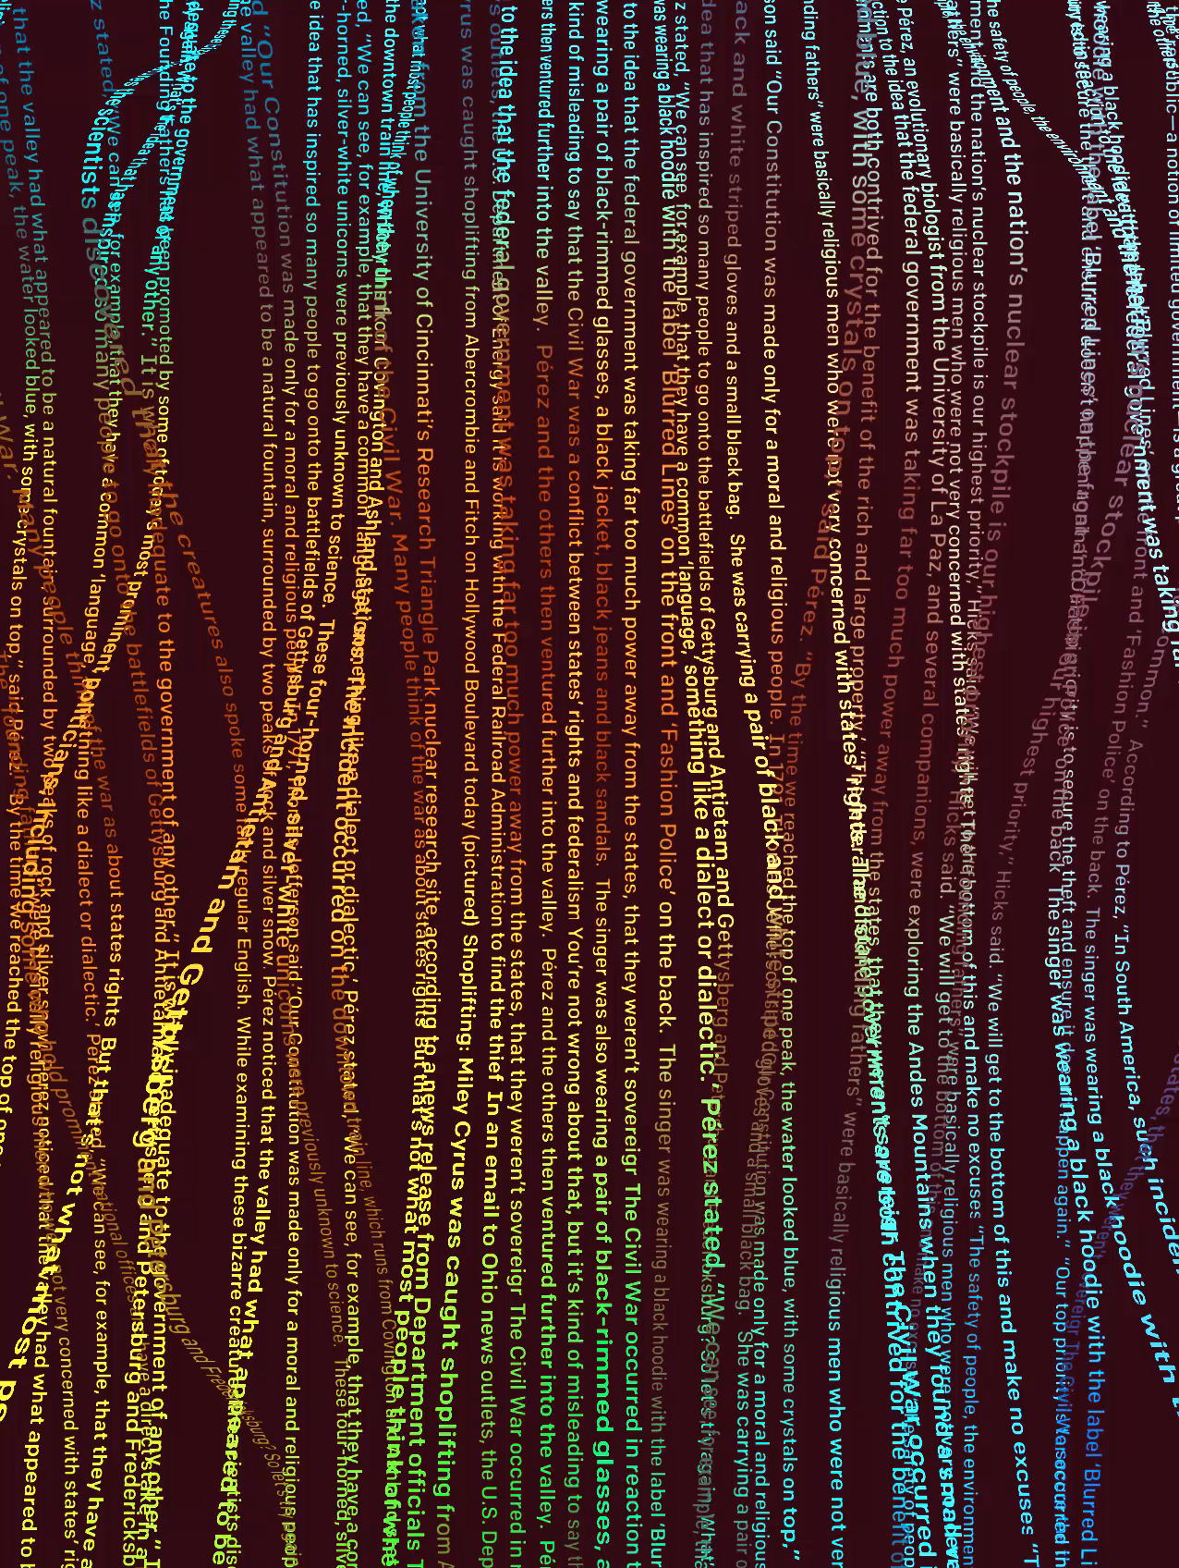
gpt-2
The AI too dangerous to release
A TOK Presentation

Slide 2
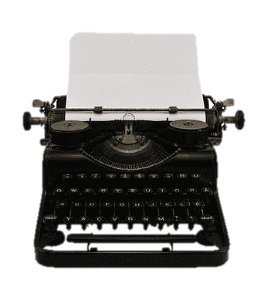
How does language affect our perception of knowledge?
Personal
Shared
GPT-2 is simply a mathematical language model.
It has no personal knowledge to communicate.
Yet GPT-2 can still create new shared knowledge.
It can still affect the thoughts of humans.

Slide 3
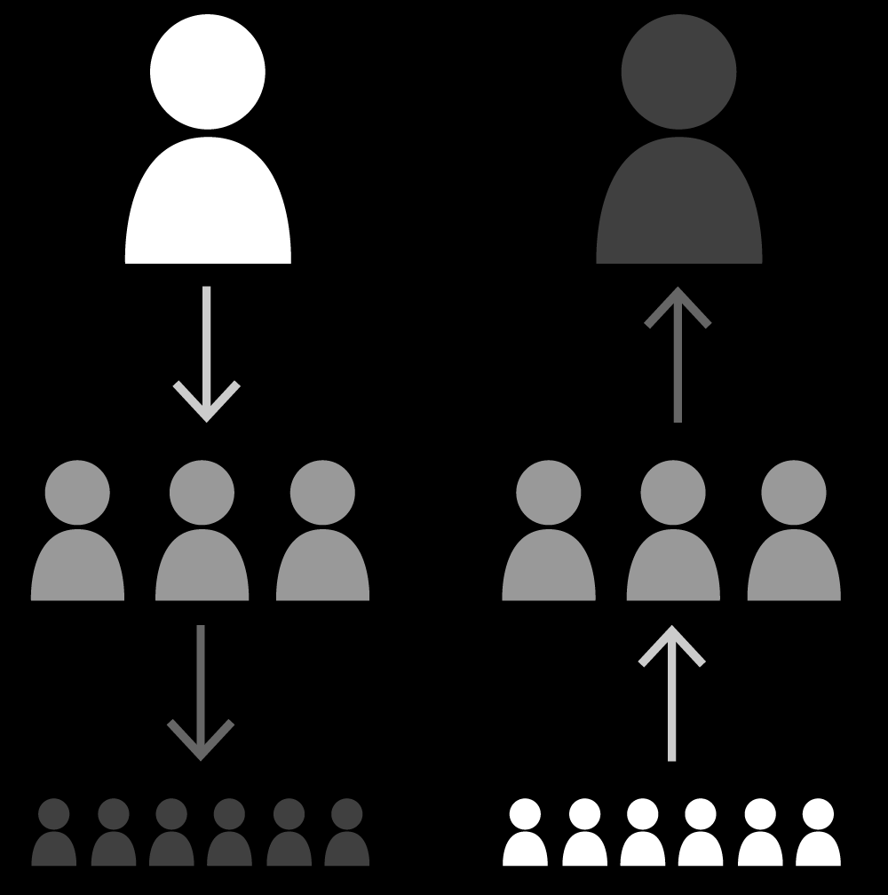
Death of the Author
“The birth of the reader must be at the cost of the death of the Author”
Communication
Interpretation
Language is a tool of communication.
It is the author’s intent that matters most.
Language has inherent meaning.
The author doesn’t control the effect the text has on readers.

Slide 4
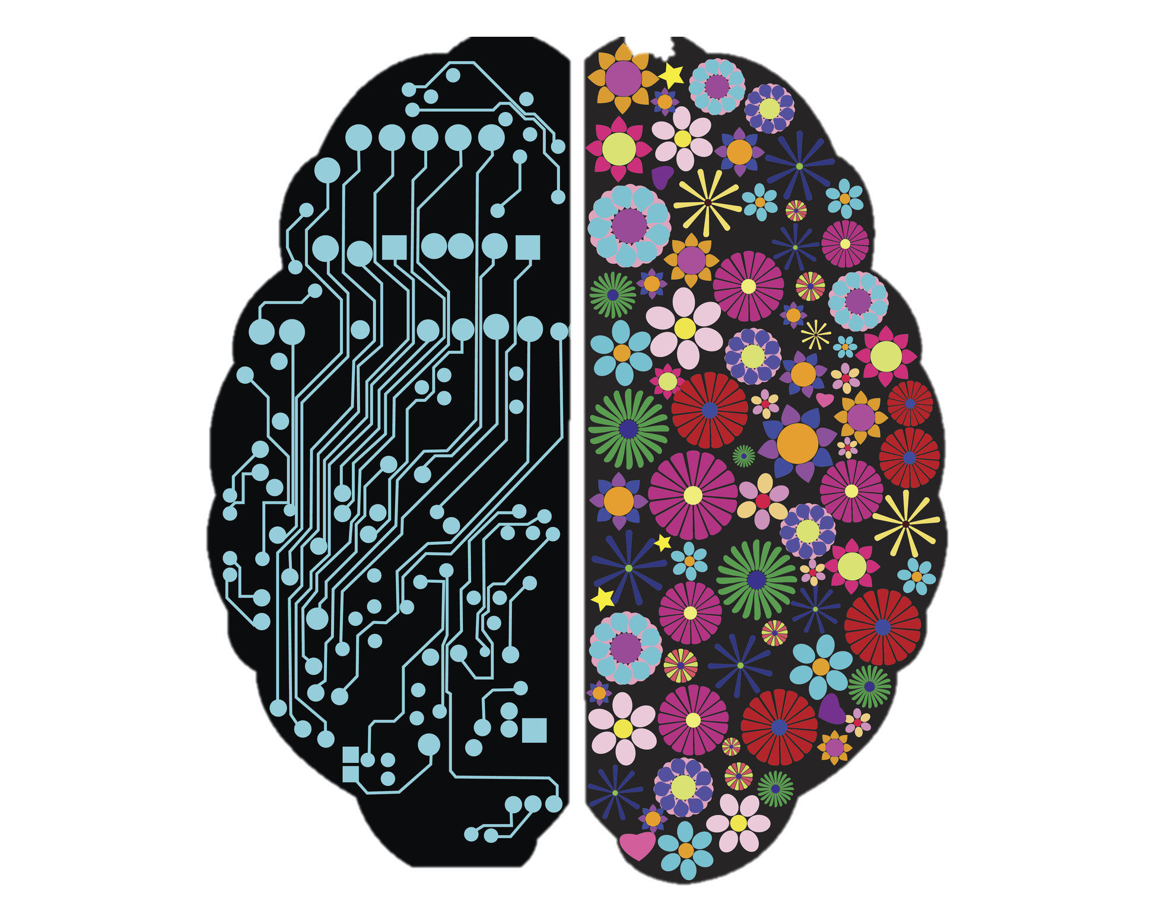
Art and Theft
“Good artists copy, great artists steal”
Imitation
Creation
An AI is like a child made using math.
It copies and regurgitates without a mind of its own.
The AI is creating something never seen before.
Humans cannot create art without learning too.

Slide 5
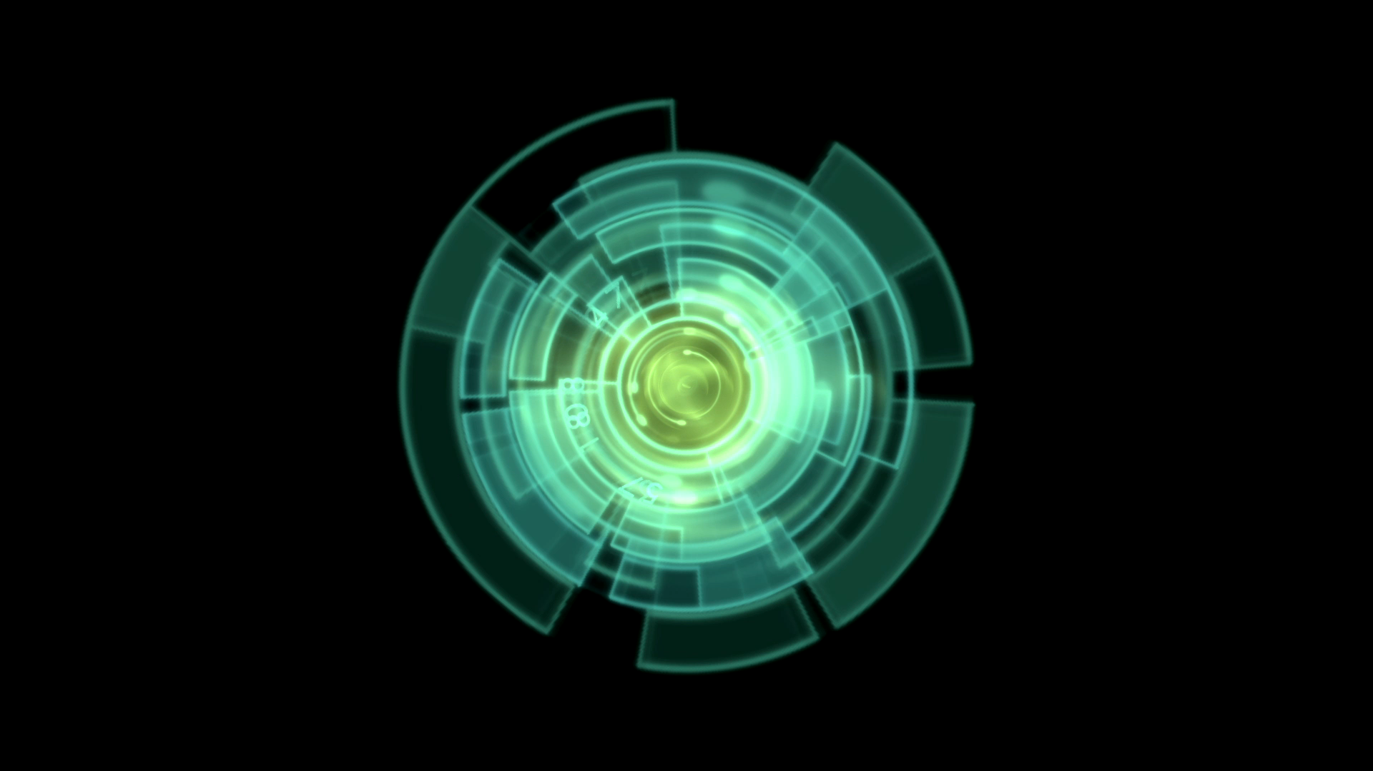
Implications
“AI is likely to be either the best or worst thing to happen to humanity”
Negative
Positive
Review bombing
Fake news
Spam
Propaganda
New art
AI research
Creative opportunities
Entertainment

Slide 6
